Slide 1
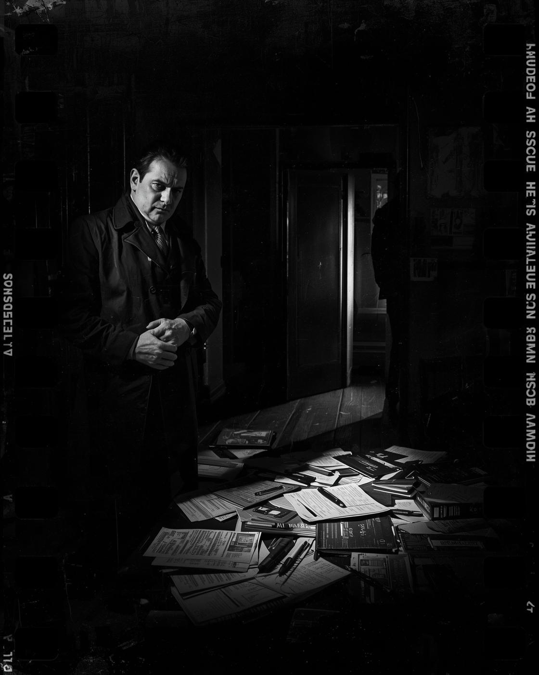

SQL Murder Mystery:
Who killed the CEO
Case solved by Rishabh Bahuguna

Slide 2

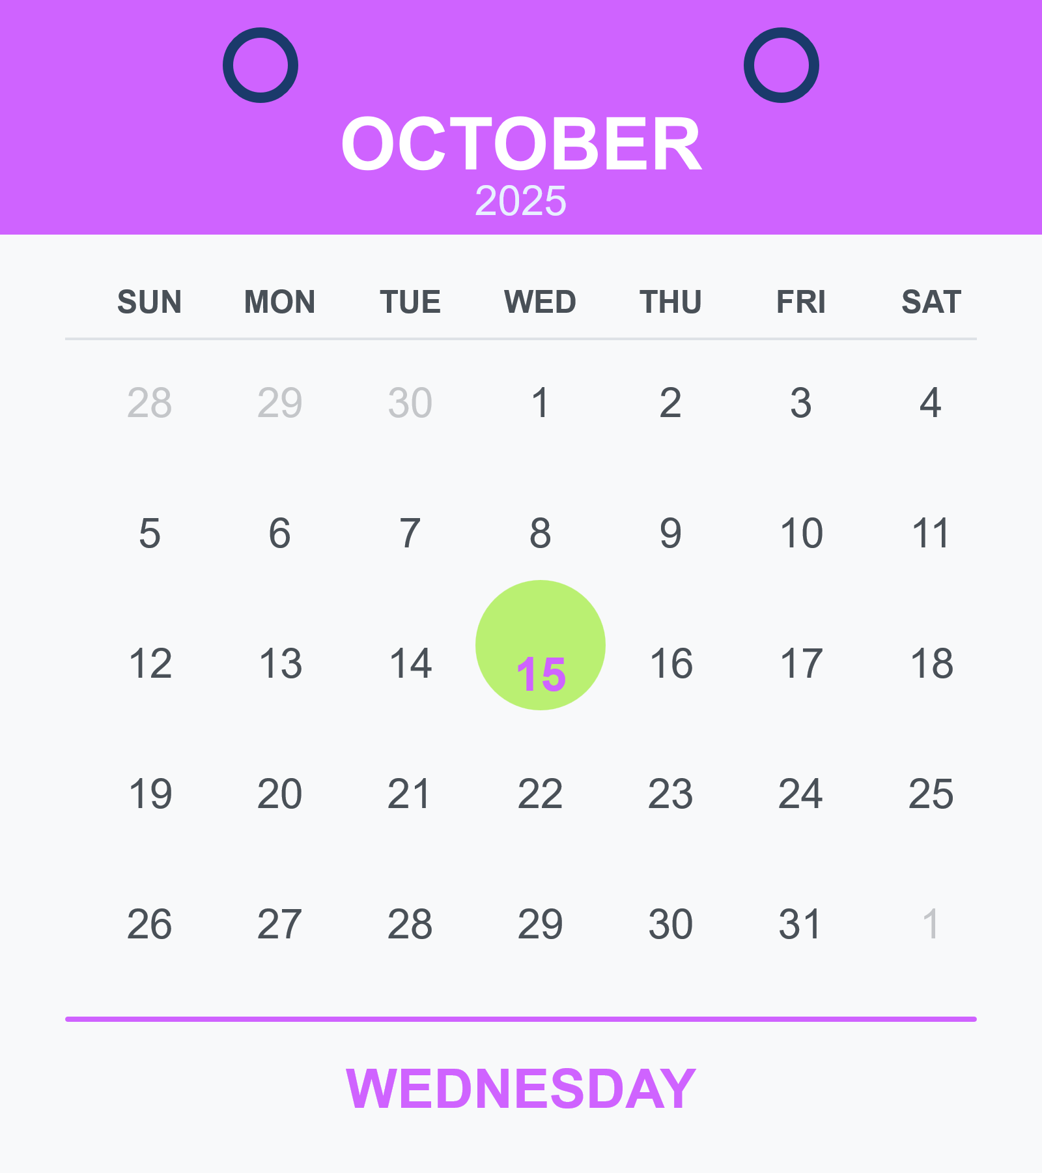


At the crime scene
The CEO of TechNova Inc. was found dead in their office.
09:00 PM
21:00 Hrs. as per our database.
Who am I and what is my mission?
I am a lead data analyst at TechNova Inc., and my mission is to find out:
a) who the killer is
b) where and when the crime took place, and
c) how it happened
Technical aspect: For investigating this case, I’m using PostgreSQL (latest version 18.1) | pgAdmin 4 (latest version 9.10) as an analytics tool
2

Slide 3

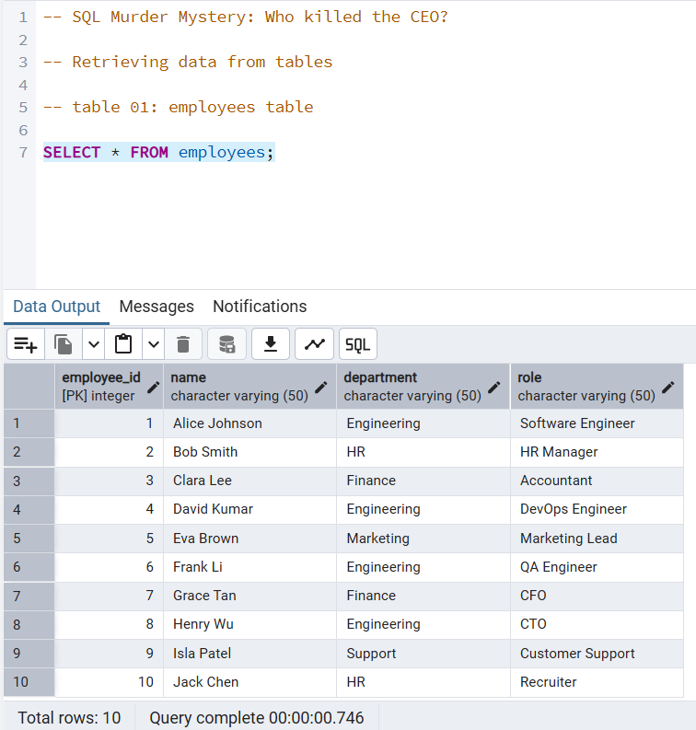

employees table
Tables: where our clues are hidden.
This will help us explore the evidence concealed within the data.
Concept check: Here is the overview of table basics in Data Definition Language.
3

Slide 4
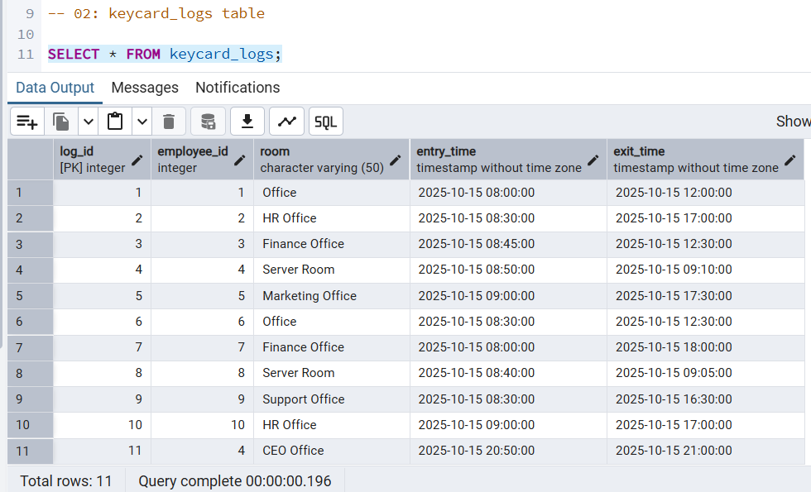
keycards_log table
Concept check: CREATE TABLE is a Data Definition Language (DDL) command used to define the structure of a new table within a database.
4

Slide 5
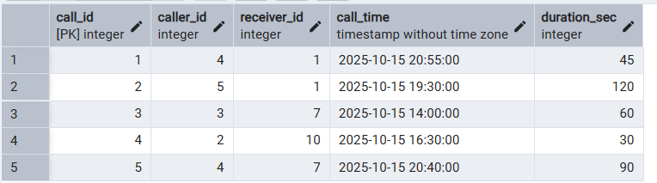
calls table
Concept check: ALTER TABLE is a DDL command used to modify the structure of a table within a database.
5

Slide 6
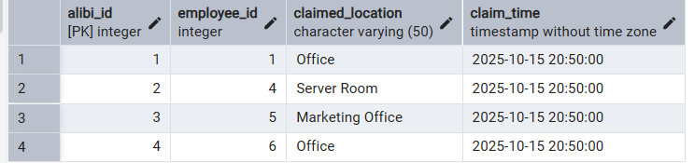
alibis table
Concept check: DROP TABLE is a DDL command used to delete the table and its components in a database permanently.
6

Slide 7
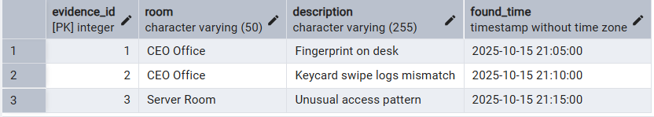
evidence table
Concept check: TRUNCATE TABLE is a DDL command used to remove all the rows from the table while preserving the table’s structure within a database.
7

Slide 8

SQL Investigation
Let’s unravel the mystery through SQL queries.
Technical aspect: Pre-read- Basics of querying a table, here.
8

Slide 9

Investigation Framework
Identify where and when the crime happened
2. Analyse who accessed critical areas at the time
3. Cross-check alibis with actual logs
4. Investigate suspicious calls made around the time
5. Match evidence with movements and claims
6. Combine all findings to identify the killer
Global demand: According to the World Economic Forum’s Future of Jobs Report 2025, core skills in 2025.
9

Slide 10

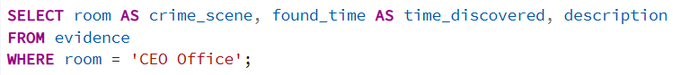
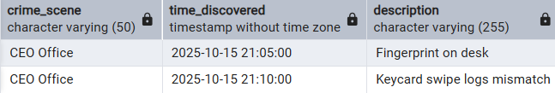
Identify where and when the crime happened
SQL Query:
Investigation result:
Crime scene findings:
The evidence confirms the crime took place inside the CEO Office, with traces appearing between 21:05 and 21:10 Hrs.
Concept check: Data Query Language (DQL)- Data Retrieval using SELECT statement and filtering using WHERE clause
10

Slide 11

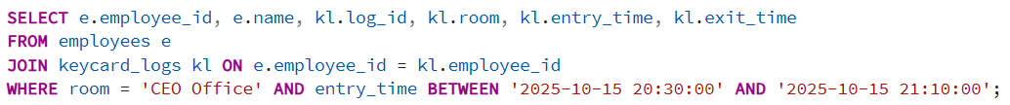
2. Analyse who accessed critical areas at the time
SQL Query:
Investigation result:
Crime scene findings:
The access logs show that only one person entered the CEO's Office within the critical window, narrowing the investigation to a single potential suspect.
Concept check: Filtering with the BETWEEN operator checks whether a value falls under a specified range.
11

Slide 12

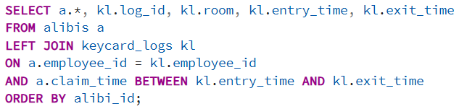
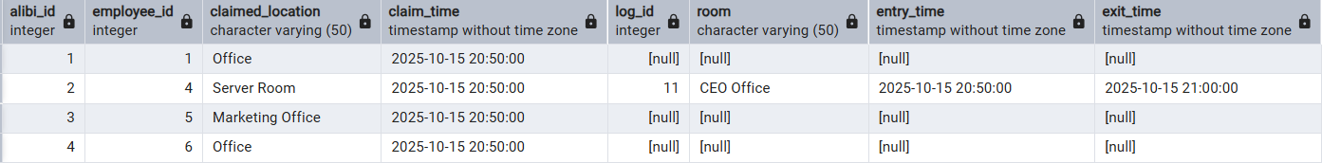

3. Cross-check alibis with actual log
SQL Query:
Investigation result:
Crime scene findings:
Only one alibi matches with an actual keycard entry. The employee who claimed to be in the CEO's Office at 20:50 Hrs. is the same one whose swipe log confirms access at that time.
Concept check: LEFT JOIN operation retains all rows from the left table and adds matching rows from the right, displaying nulls when no match exists.
12

Slide 13

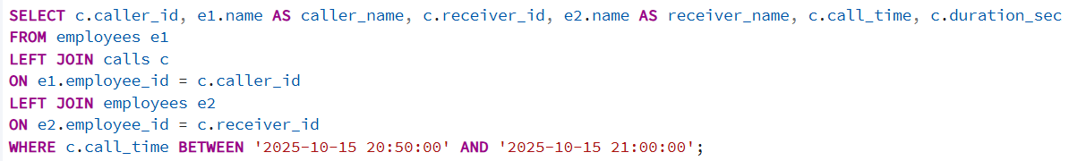
4. Investigate suspicious calls made around the time
SQL Query:
Investigation result:
Crime scene findings:
Only one call took place within the time window, indicating that David Kumar contacted Alice Johnson at 20:55 Hrs., making it a key interaction to note during the incident.
13
Concept check: LEFT JOIN operation retains all rows from the left table and adds matching rows from the right, displaying nulls when no match exists.

Slide 14

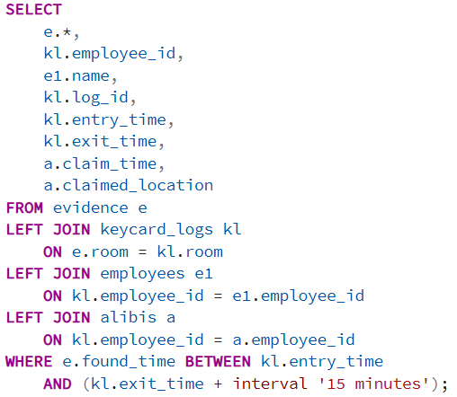
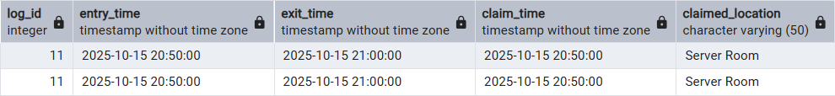
5. Match evidence with movements and claims
SQL Query:
Investigation result:
Note: The complete result set contains 11 columns.
Crime scene findings:
All evidence in the CEO’s Office, including the fingerprint and keycard mismatch, aligns with David Kumar’s movements and claimed location, linking him directly to the scene during the incident.
Concept check: LEFT JOIN operation retains all rows from the left table and adds matching rows from the right, displaying nulls when no match exists.
14

Slide 15

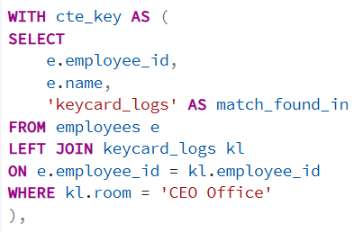
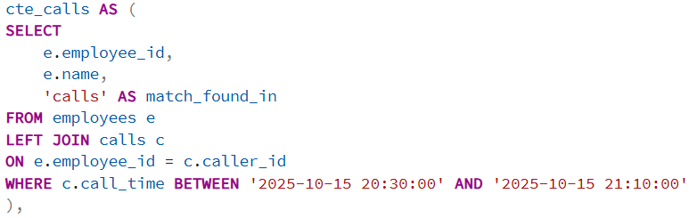
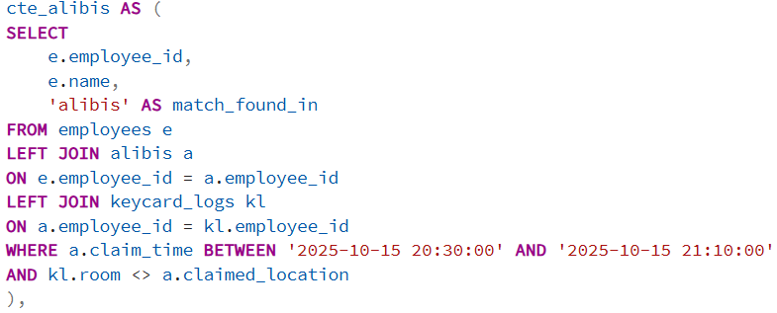
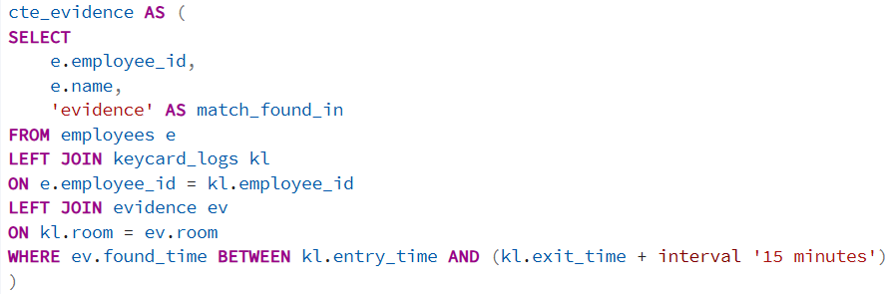
6. Combine all findings to identify the killer.
SQL Query:
cte_1
cte_2
cte_3
cte_4
15
Concept check: Common Table Expressions (CTEs) create temporary named result sets that only exist during the execution of a single query.

Slide 16

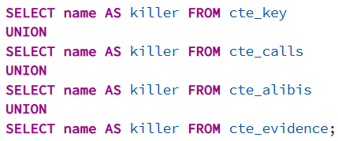
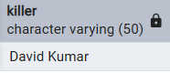
Behind the alibi: a killer exposed
SQL Query:
Note: Part of a larger CTE chain. Refer to the previous slide for the WITH clause
Investigation result:
Concept check: UNION operator combines the result sets of two or more SELECT statements into a single result set, by default removing duplicate rows.
16

Slide 17

Case closed
We’ve found the killer using our investigation with SQL
As leaders advance, they expect teams to grow their business acumen. Here is the need highlighted by Harvard Business Publishing Corporate Learning
17

Slide 18





Thank you for your attention
Special thanks to:
and
For this investigation, I, Rishabh Bahuguna, took on the role of lead data analyst at TechNova Inc. and used my SQL and detective skills to work through the case.
Want to know more about this analyst (with honed detective skills)?
Reach out with your case here:
|

